Slide 1

The Role of Information in the Logic of Power
Anton Sobolev
University of Central Florida | Spring ’26

Slide 2
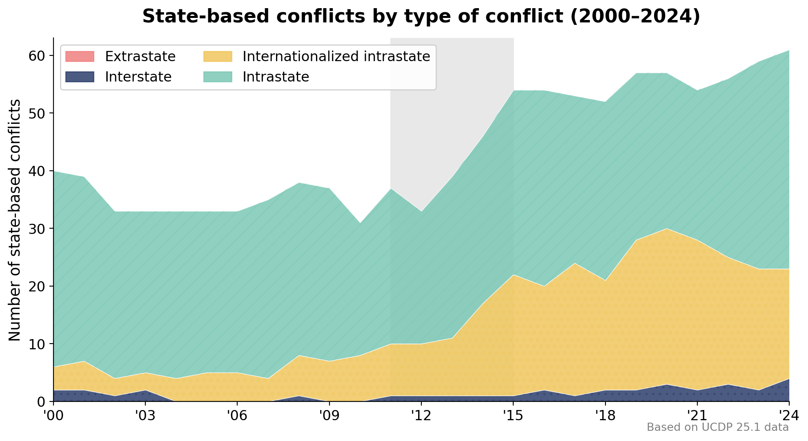
Information in the Logic of Power
Research Agenda & Historical Context
conflict
■ What does explain power dynamics?
□ Geography □ Institutions □ World Economy □ Prod. Technology
■ Yet we observe Starting 2010x
□ Not a spike, but a transition to a new equilibrium □ Other things being equal?
Rueschemeyer et al (1992) Boix (2003) Ben & Samuels (2014)
North (1995) Acemoglu
et al (2001)
Rogowski (1989) Hiscox (2002)
Diamond (1997) Ross (2001) Sachs (2003)
new equilibrium

Slide 3

Information in the Logic of Power
Research Agenda & Historical Context
conflict
■ What does explain power dynamics?
□ Geography □ Institutions □ World Economy □ Prod. Technology
■ Yet we observe Starting 2010x
□ Not a spike, but a transition to a new equilibrium □ Other things being equal?
■ Emerging Field Information & Communication in Politics
□ Independent Role of ICT [≠ Propaganda]
□ Global Re-emergence (and Re-invention) of Censorship
□ New types of Political □ Actors: Platforms, Pirate Parties, Influencers Policy □ Agents: Bots (and Viruses), Trolls, Scams, APT groups
Rueschemeyer et al (1992) Boix (2003) Ben & Samuels (2014)
North (1995) Acemoglu
et al (2001)
Rogowski (1989) Hiscox (2002)
Diamond (1997) Ross (2001) Sachs (2003)
new equilibrium

Slide 4
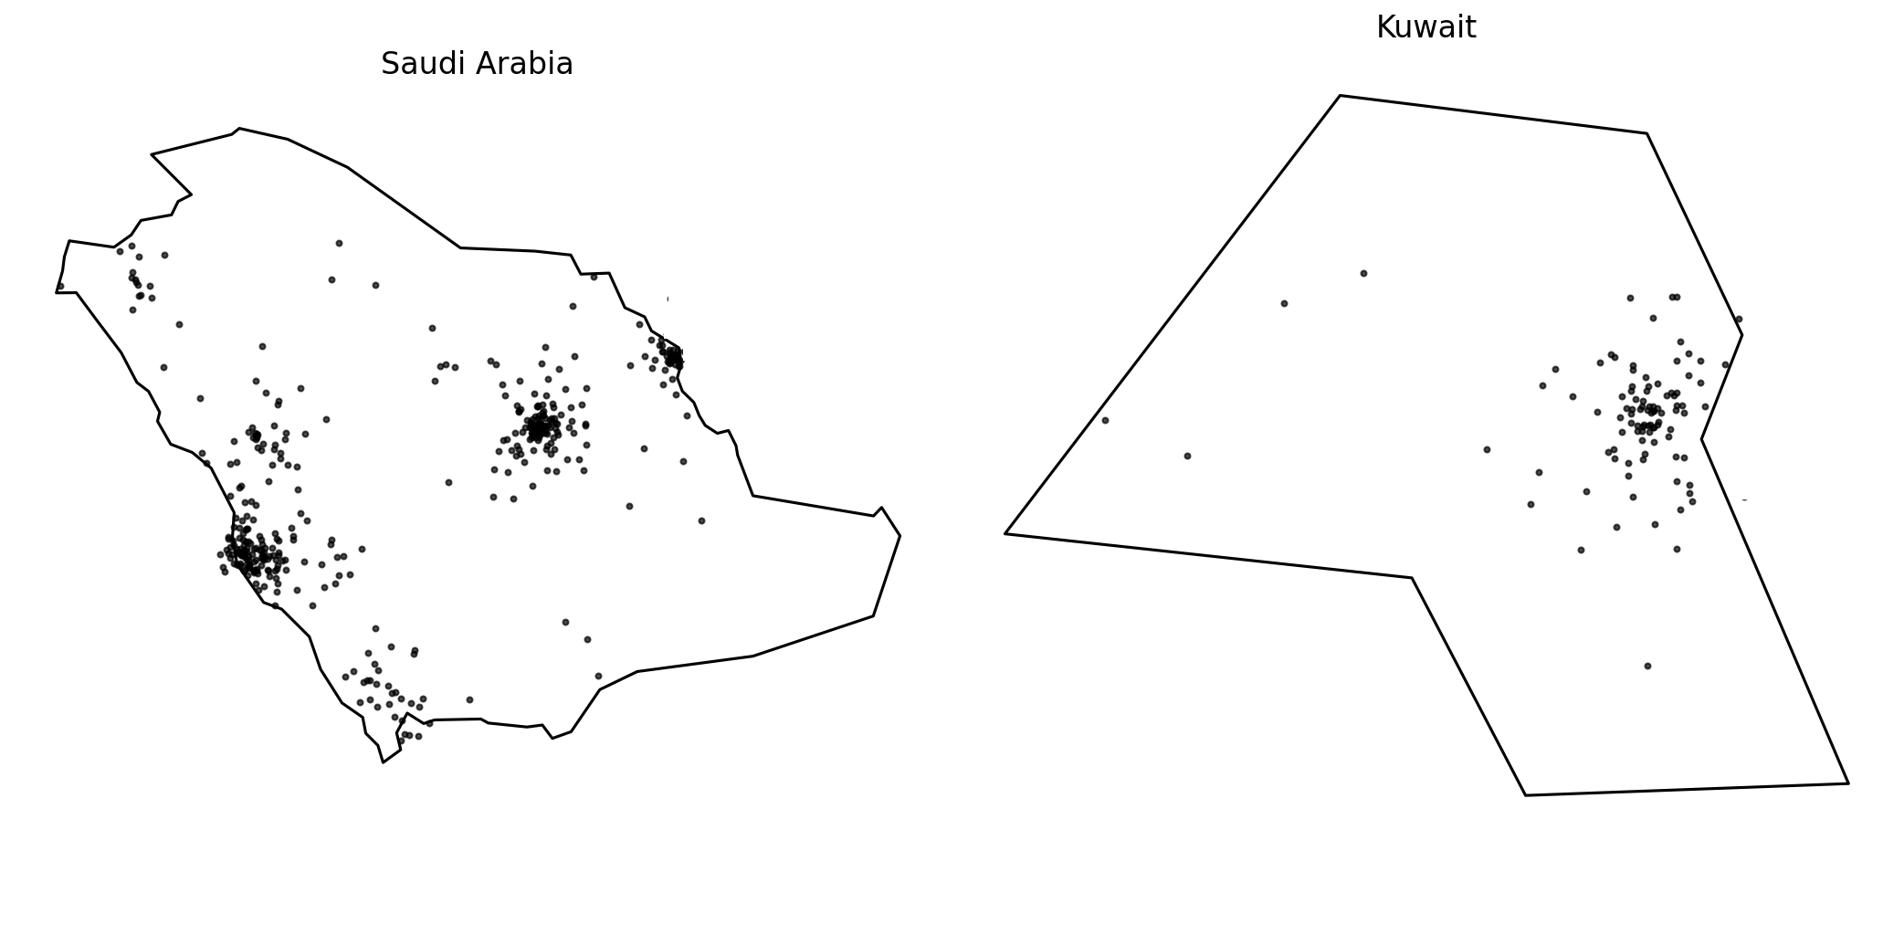
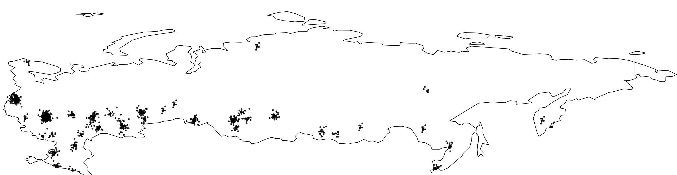
Information in the Logic of Power
Research Agenda & Historical Context
■ Starting Point □ Geography
■ Case of Mass Actions 2011-12, Russia, Regions
Campante & Do (2009), Campante (2012), Campante & Do (2014)
Diamond (1997) Ross (2001) Sachs (2003)
Russia

Slide 5
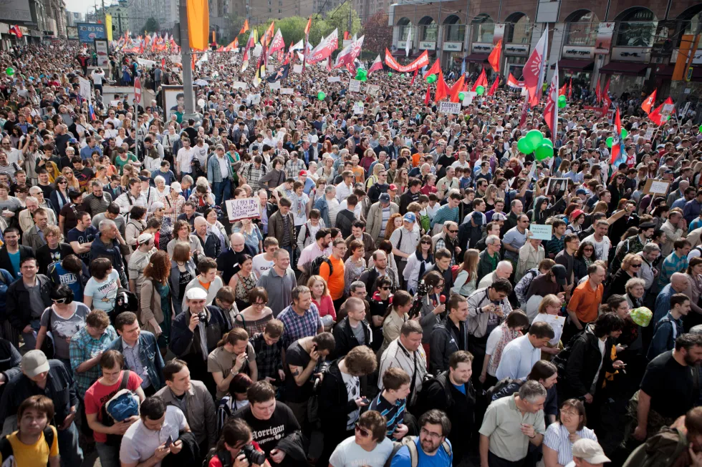
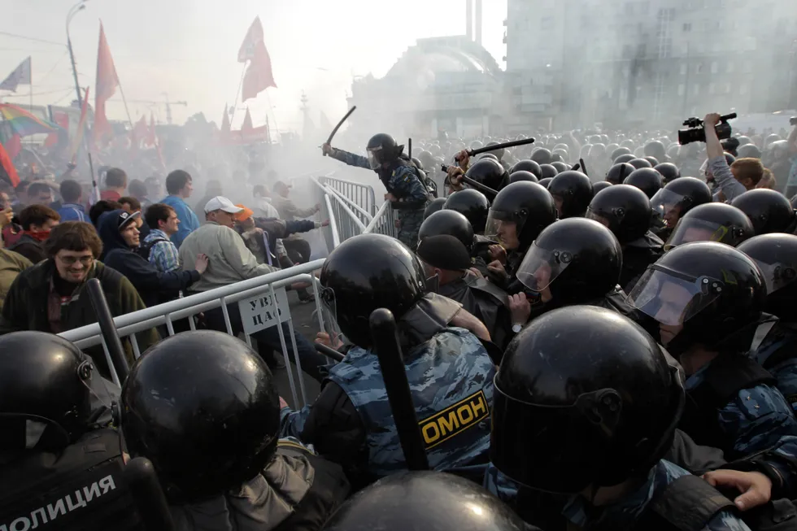
Information in the Logic of Power
Research Agenda & Historical Context
■ Starting Point □ Geography
■ Case of Mass Actions 2011-12, Russia, Regions, Sobolev (2014)
□ Expectations: □ Contentious Dynamics is determined by geographic factors □ Population Allocation □ Climate □ Rough Terrain
□ Compare with: □ Economic Growth □ Unemployment □ per capita Growth
□ Findings: ☑ Comparable Effects with Economic Factors
☑ ICT indicators (networks, computers, cellphones, information accessibility, internet traffic)
mattered even more!
Campante & Do (2009), Campante (2012), Campante & Do (2014)
Diamond (1997) Ross (2001) Sachs (2003)

Slide 6
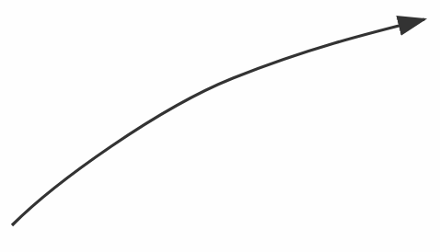
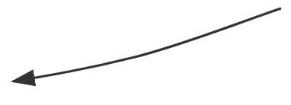
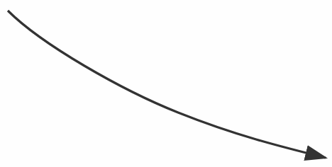
Paths & Pathways
Political Power & Three Information-Related Nodes
Infrastructure
Technology & Transmission
Political Power
Obey Voluntarily
Content
Type & Style of Interaction
Perception
Sensors & Stresses

Slide 7
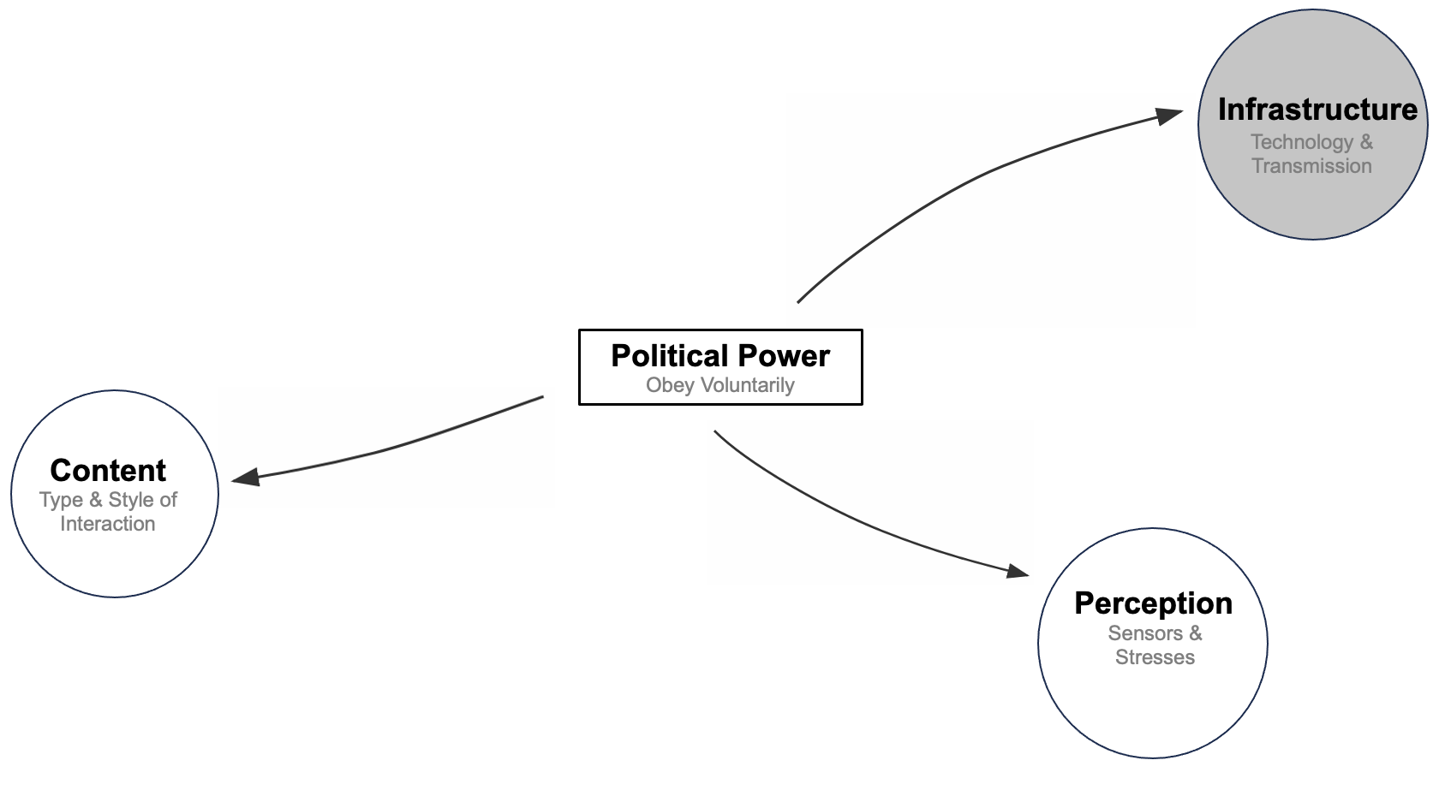

Information Infrastructure
Echo of Freedom:
How Independent Media Contain Dissent
Fake Rally
Dissent
More Nuances
Sender [Autocract]
Receiver [Citizen]
No
No
Wintrobe (1998), Egorov, Guriev, Sonin (2009), Edmond (2008, 2013), Kricheli, Livne & Magaloni (2011), Ho (2020), King, Pan, Roberts (2013, 2016), Roberts (2018), Xu (2022)

Slide 8
Information Infrastructure
Echo of Freedom:
How Independent Media Contain Dissent
Fake Rally
Dissent
Sender [Autocract]
Receiver [Citizen]
No
No
Fake Rally
Dissent
[State]
[Investigations]
[Platforms]
Signal [strength]
Ownership
Control
Censorship
Citizen [Beliefs]
No
[Private]
[Reporting]
[Self-Censor]
No
Wintrobe (1998), Egorov, Guriev, Sonin (2009), Edmond (2008, 2013), Kricheli, Livne & Magaloni (2011), Ho (2020), King, Pan, Roberts (2013, 2016), Roberts (2018), Xu (2022)

Slide 9
Information Infrastructure
Echo of Freedom:
How Independent Media Contain Dissent
Fake Rally
Dissent
Sender [Autocract]
Receiver [Citizen]
No
No
Fake Rally
Dissent
[State]
[Investigations]
[Platforms]
Signal [strength]
Ownership
Control
Censorship
Citizen [Beliefs]
No
[Private]
[Reporting]
[Self-Censor]
No
[Credibility]
What happens in this case?
Report: rally
do not investigate: fake
Students: What is the challenge with mf?
Wintrobe (1998), Egorov, Guriev, Sonin (2009), Edmond (2008, 2013), Kricheli, Livne & Magaloni (2011), Ho (2020), King, Pan, Roberts (2013, 2016), Roberts (2018), Xu (2022)

Slide 10
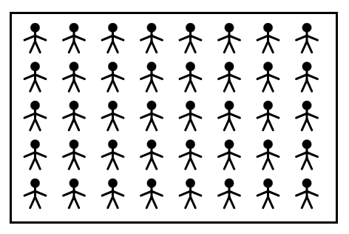
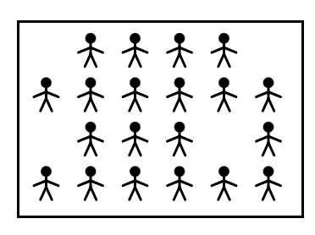
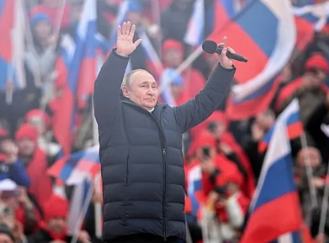
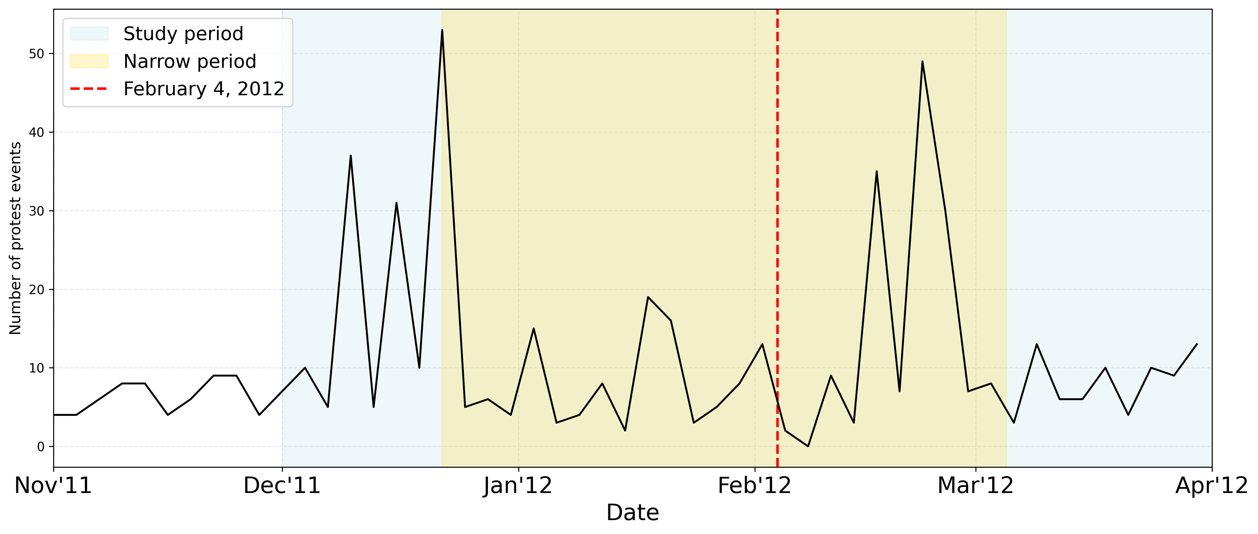
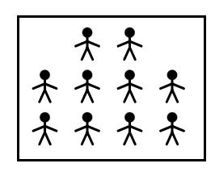
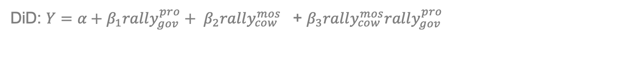
Information Infrastructure
Echo of Freedom:
How Independent Media Contain Dissent
■ Unique setting: Political Media with Economic Model
□ Local franchises of radio station “Echo of Moscow” □ “Can you hear this radio?”
■ Outcomes: mass anti-government actions 2011-12, Russia, Cities
■ Treatment: pro-government rallies
□ A local pro-government rally? (Feb 4, ‘12) ⟿ Mass Actions ↑ ↓
Up
Rally
Citizen
Signal Fake Rally
With radio
Citizen Fake Rally
No
Down
DiD: $Y=α+β_{1}rally_{gov}^{pro}+ {β_{2}rally_{cow}^{mos}}^{}$+ $β_{3}rally_{cow}^{mos}rally_{gov}^{pro}$

Slide 11
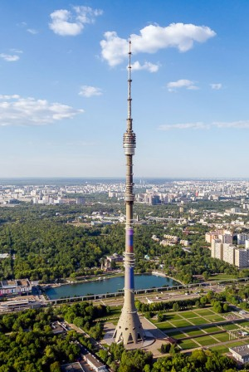
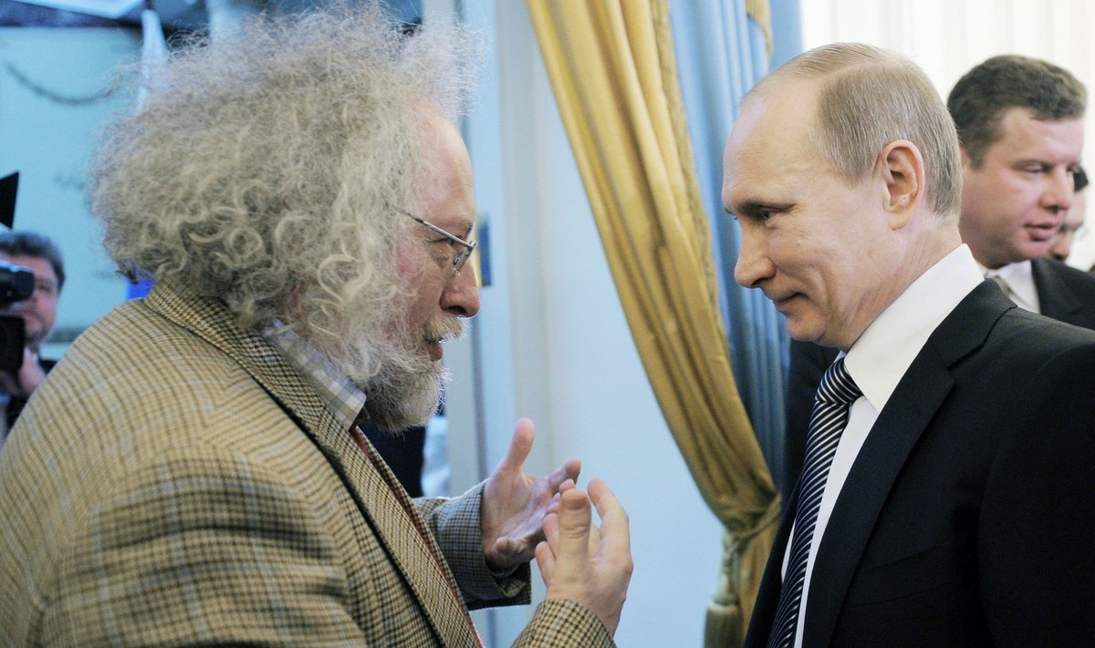
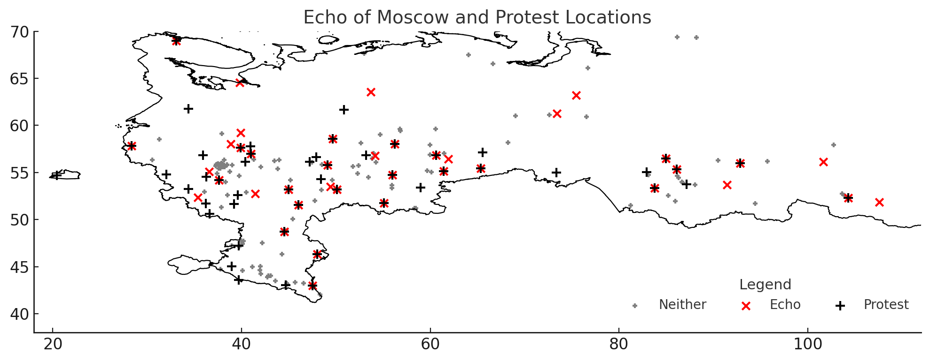
Information Infrastructure
Echo of Freedom:
How Independent Media Contain Dissent
■ Unique setting: Political Media with Economic Model ■ Two types of locations with radio signal
Ads on an independent radio station
■ 273 cities / 72 stations

Slide 12
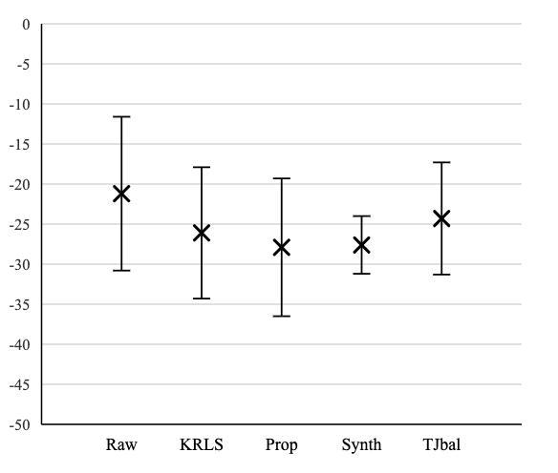
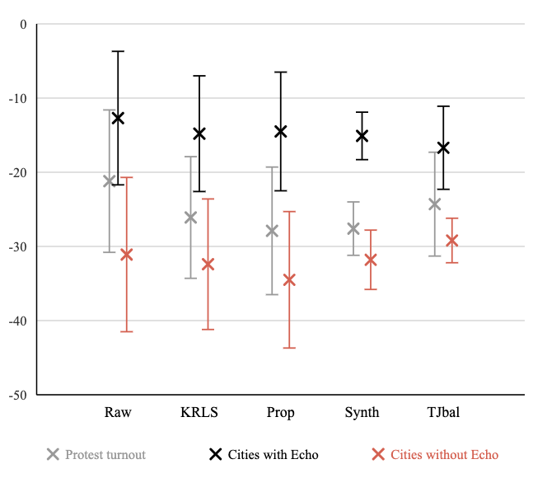
Information Infrastructure
Echo of Freedom:
How Independent Media Contain Dissent
■ Effect of a pro-government rally
■ Conditional on the exposure to the radio signal
□ Propensity Score Matching
□ Kernel Balancing
□ Synthetic Control
□ Trajectory Balancing

Slide 13
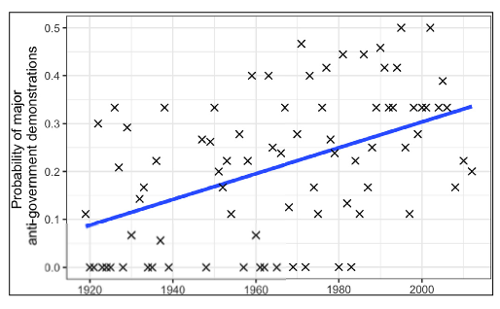
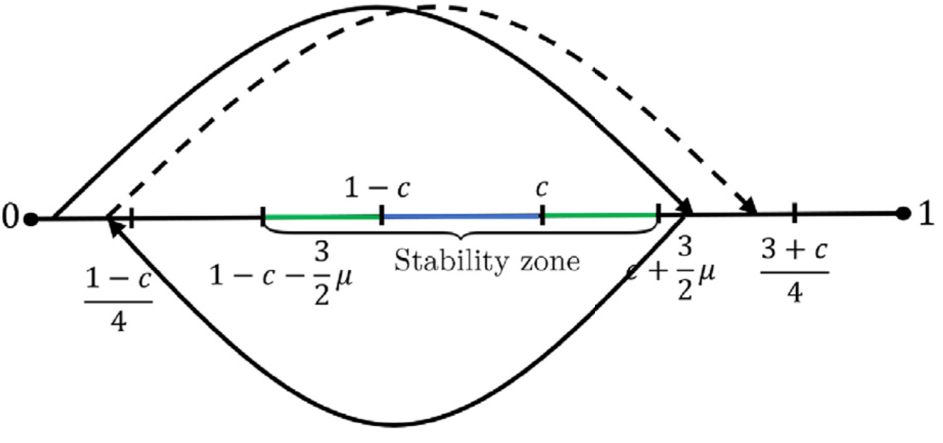
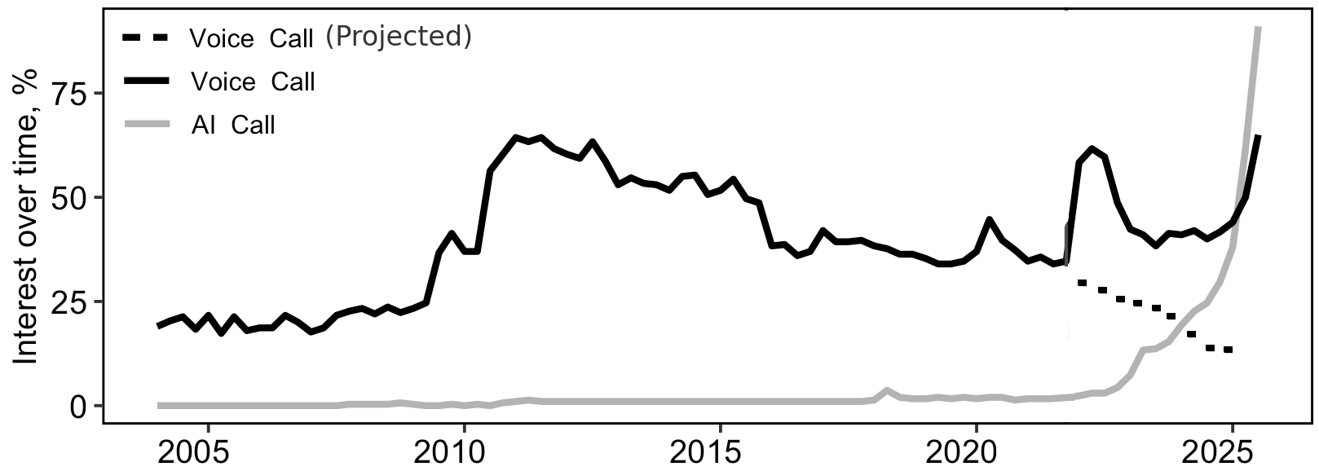
Paths & Pathways
Information Infrastructure
■ Information Availability via ICT & Newly Established Governments (EJPE, 2019)
■ The Last Call for Authenticity: AI Voice Scams (JCP, 2025)
□ Underestimated growing threat of voice synthesis □ Combo of qualitative and quantitative evidence for:
The increasing asymmetry between the low cost of launching voice-based attacks and the high cost of preventing them undermines trust in voice
as a credible communication channel.
□ Human voice no longer functions as a reliable medium of authentication □ One of general interfaces mainly used by AI agents

Slide 14
1 Trolls as a Cyber Weapon
Flexibility &
Customization
☐ Levels
┣ Macro: Manipulate platform algorithms
┗ Micro: Threaten users
☐ Targets
┣ Content-makers, commentators, readers
┗ Politicians, activists, dissidents, supporters
☐ Easy to Switch Tactics
┣ Flooding, Threats, Distraction, Persuasion
┗ Mix & Match
☐ Masked Engagement
┣ Hide Troll Identity
┗ Mimic Regular Users
Notes:
Things I will not talk today
Motivation
Place to the literature
Things I will talk:
Trolls as a tool: What makes them different from other tools of cyber offensive?
Digital Authoritarianism

Slide 15
2 Evidence ⟿ Theory ⟿ Policy ?
Flood →
Arguments →
Imitate Extremism →
⟿ Users leave
Online
Conversation
⟿
Users switch
the topic
Disentangle?
Disentangle?
Notes:
How evidence can inform the theory

Slide 16
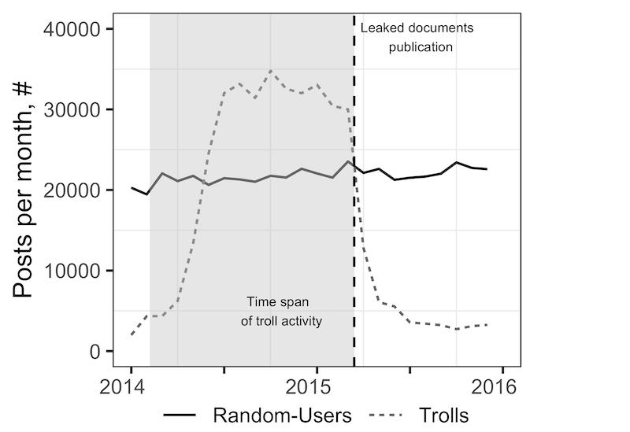
Data
☐ Troll Factory Data Leak
┣ 700 Leaked Accounts on LJ
┣ 2014-15
┗ 130k troll-infilitrated discussions
☐ Random LJ Users
┗ 4M Random Posts & Discussions
☐ Trolls’ Target
┗ Russia’s Domestic Audience
Notes:
Things I will not talk today
Motivation
Place to the literature
Things I will talk:
Trolls as a tool: What makes them different from other tools of cyber offensive?
Digital Authoritarianism

Slide 17
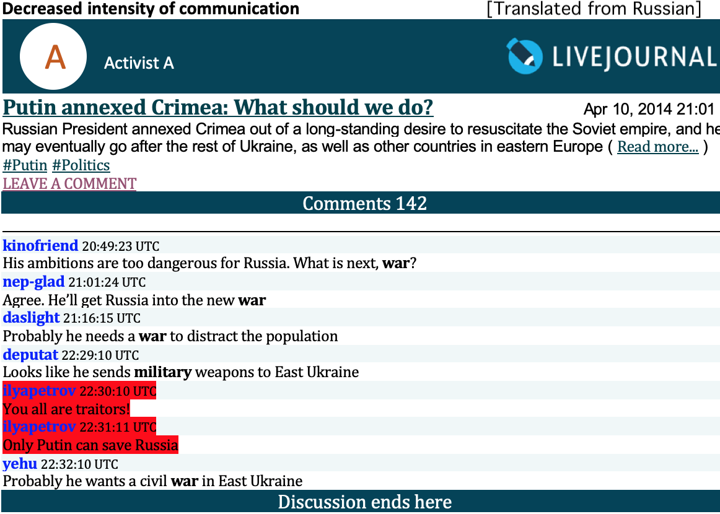

Slide 18
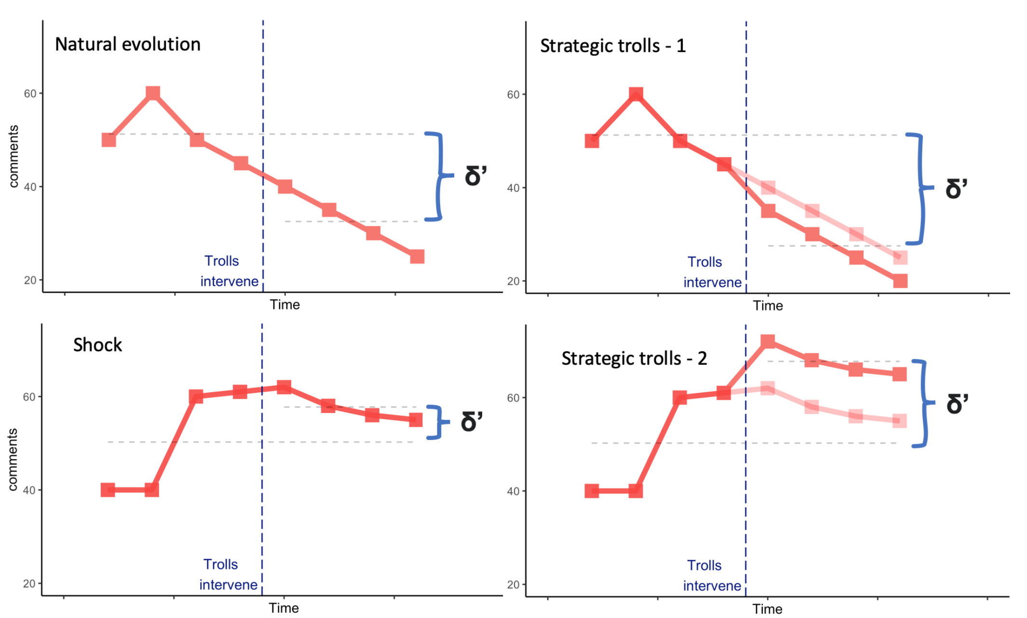
Causal Inference Challenge

Slide 19
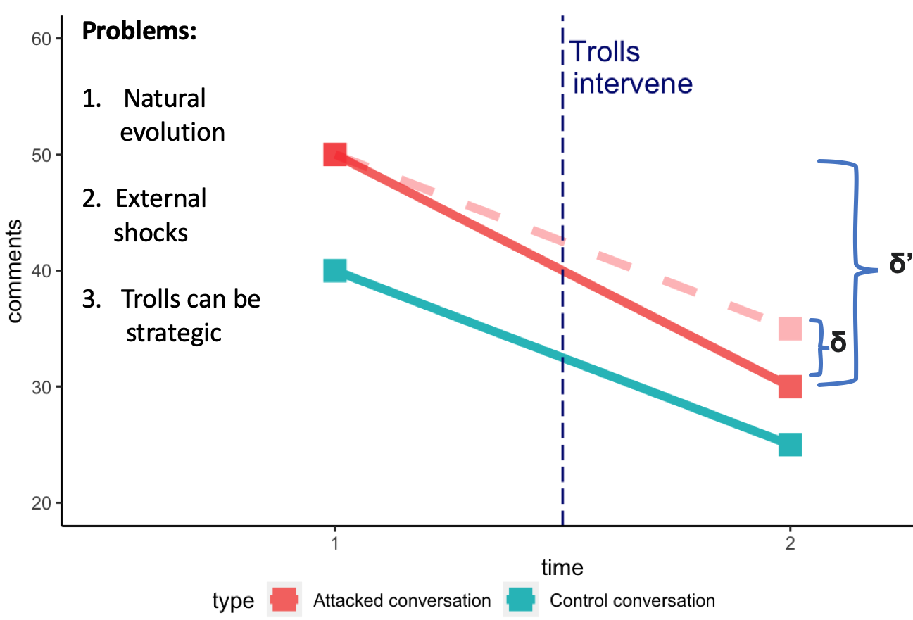
Empirical Strategy
☐ Observational Setting
┣ DiD
┗ Matching
☐ Control Conversation
┣ Discuss the same topic
┣ High chance of attack
┗ Time overlap
☐ How?
┣ Approximate DGP
┗ Simplicity of LJ Platform
Notes:
Things I will not talk today
Motivation
Place to the literature
Things I will talk:
Trolls as a tool: What makes them different from other tools of cyber offensive?
Digital Authoritarianism

Slide 20
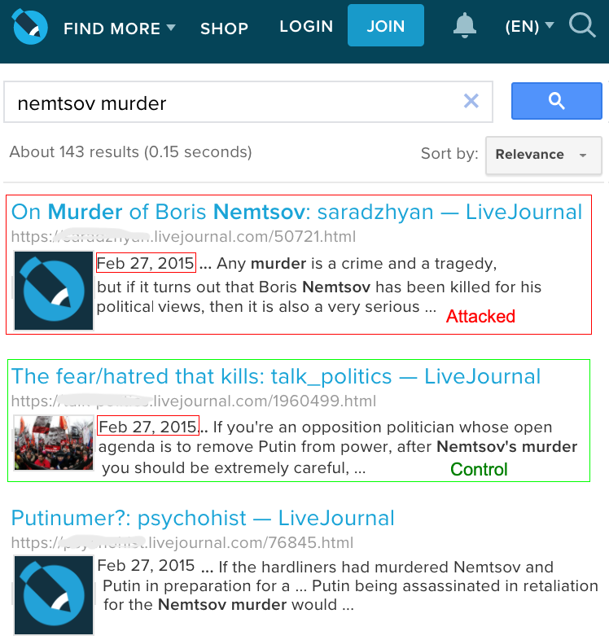
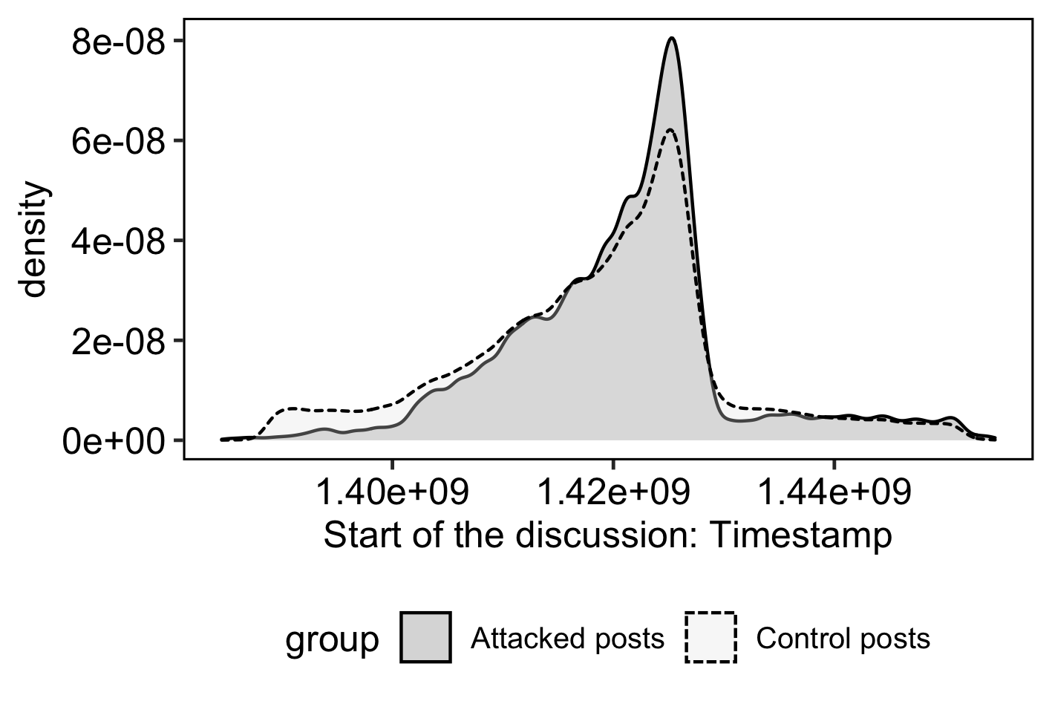
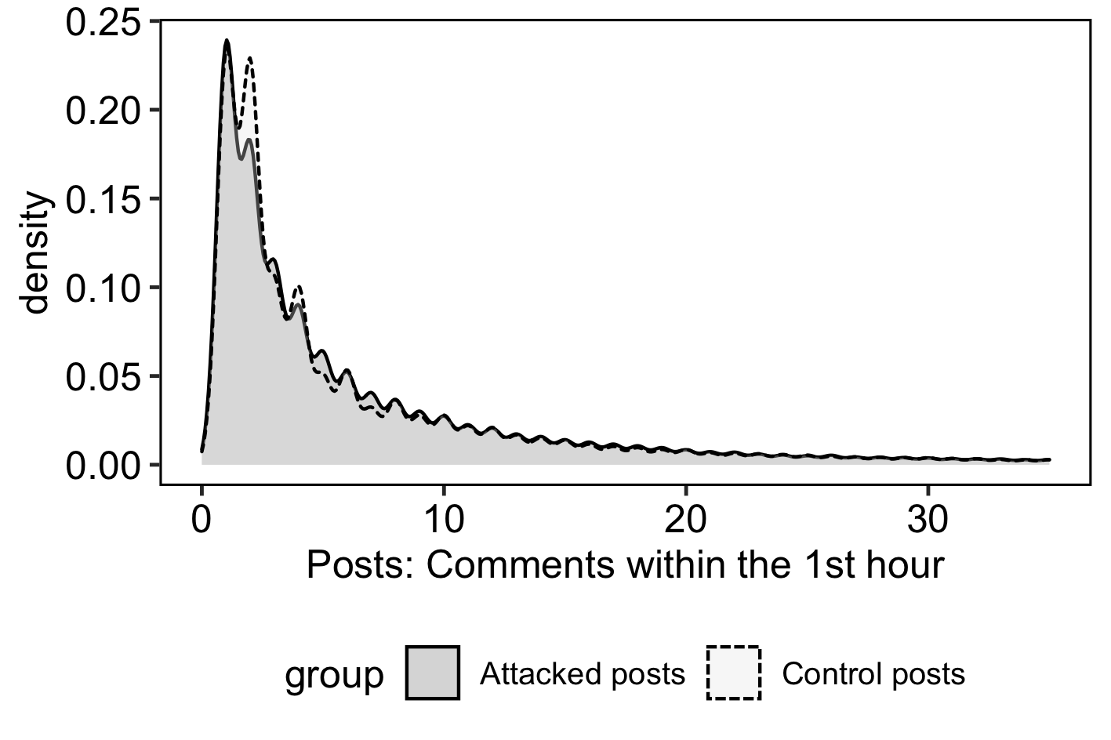
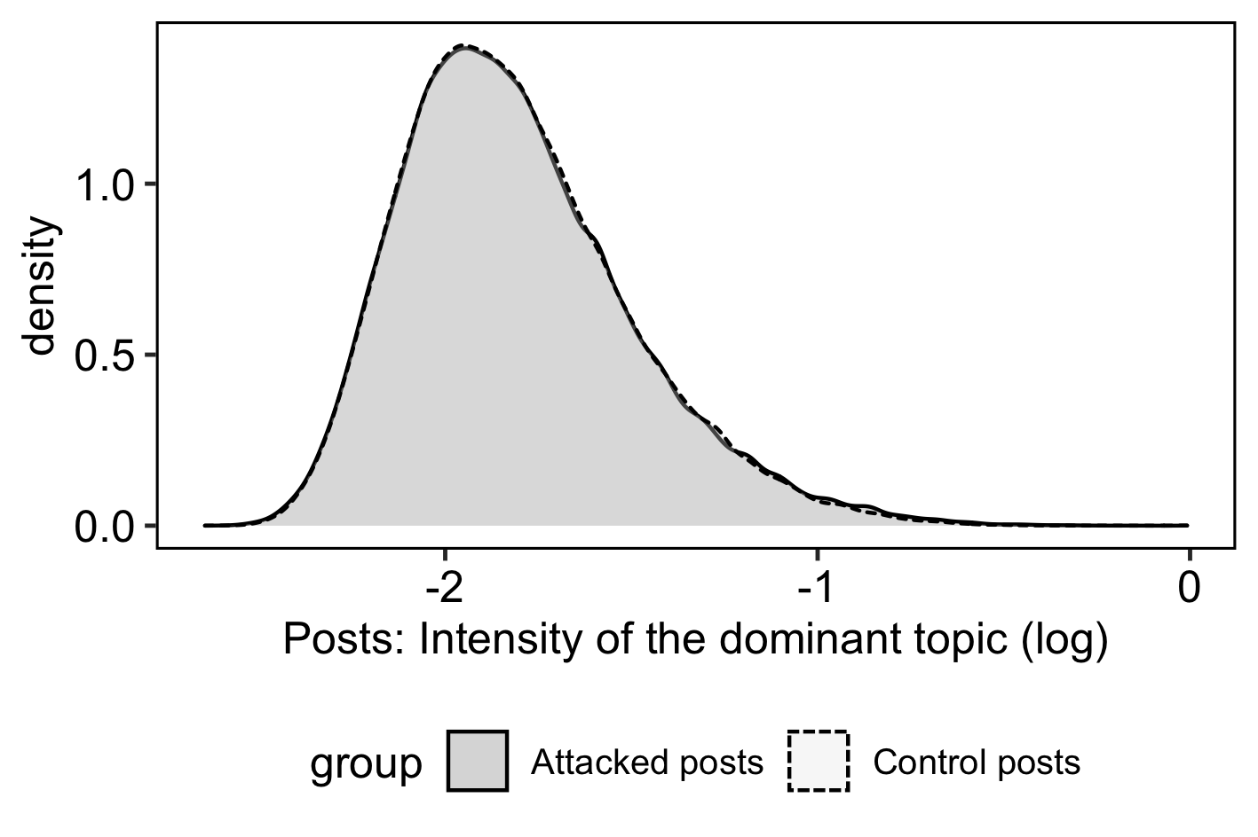
Balance

Slide 21
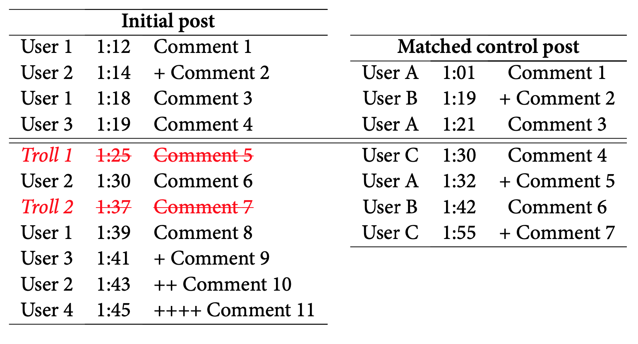
Outcomes of Interest
☐ Structural Outcomes
┣ Intensity: Comments & Threads
┗ Engagement: Users & Replies
☐ Content Outcomes
┣ Sensetive Topics
┃ Political Opposition, Economy
┃ in Crisis, War in Ukraine
┗ Agenda Promotion
NATO Aggresion
Putin’s Foreign Policy Success
Notes:
Things I will not talk today
Motivation
Place to the literature
Things I will talk:
Trolls as a tool: What makes them different from other tools of cyber offensive?
Digital Authoritarianism

Slide 22
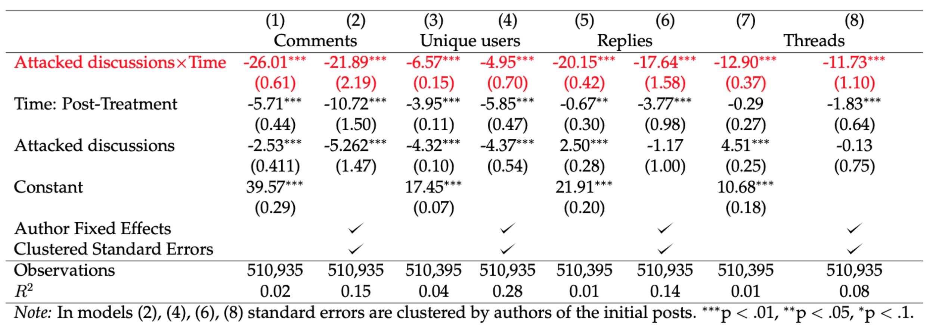
Results–1: Structural Outcomes
Notes:
Things I will not talk today
Motivation
Place to the literature
Things I will talk:
Trolls as a tool: What makes them different from other tools of cyber offensive?
Digital Authoritarianism

Slide 23
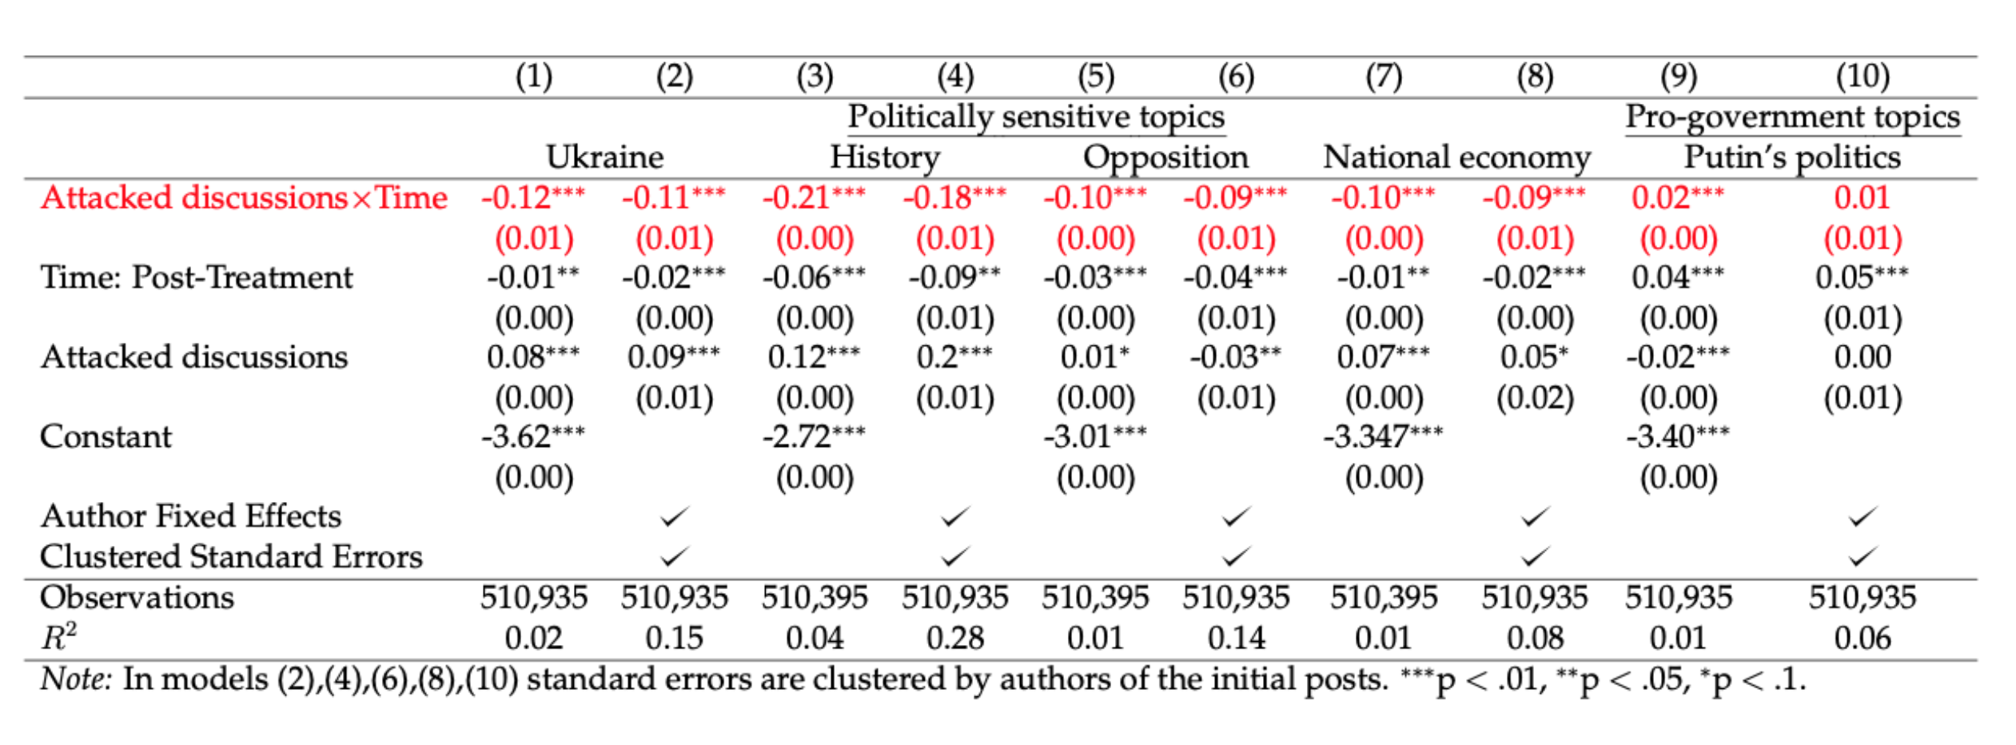
Results–2: Content Outcomes
Cases with largest effects when trolls refer to their personal experiences
Notes:
Things I will not talk today
Motivation
Place to the literature
Things I will talk:
Trolls as a tool: What makes them different from other tools of cyber offensive?
Digital Authoritarianism

Slide 24
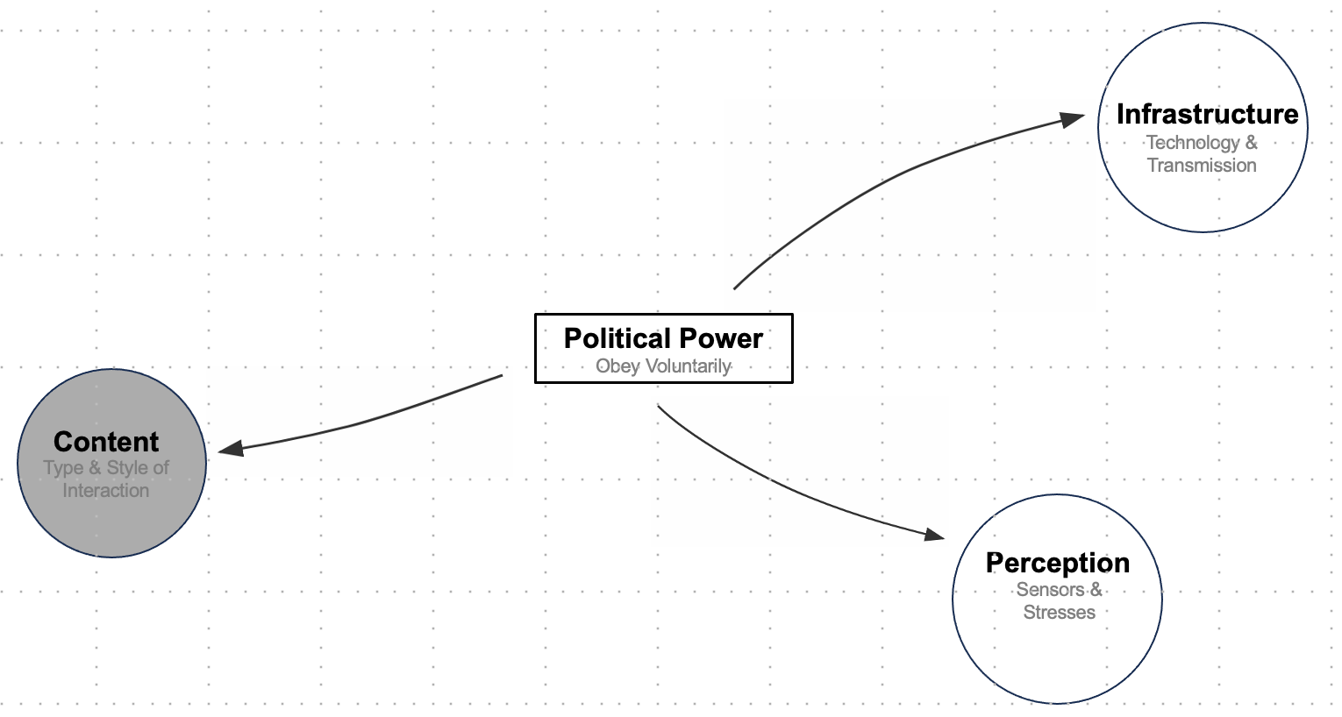
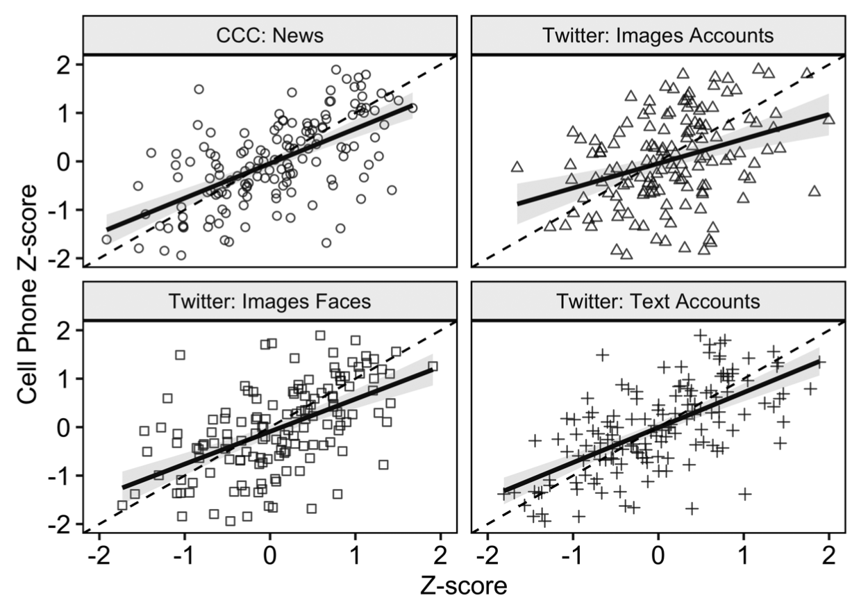
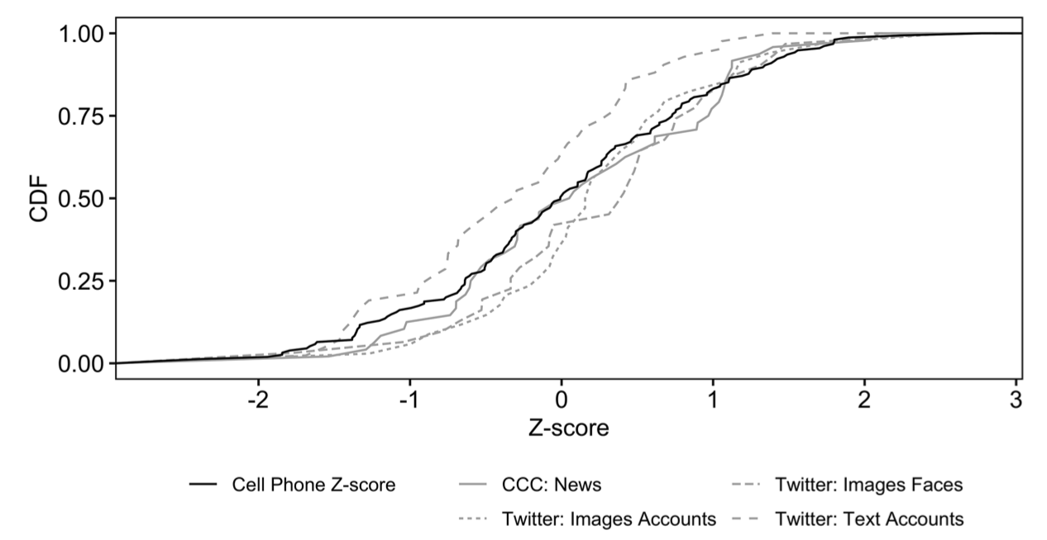
Paths & Pathways
Content Generation
■ How Reliable is Protest Data in Solving Collective Problem? (APSR, 2020) □ Information Cascades Lohmann, 1994, Kuran, 1995, Chwe. 2001
□ US Women’s Marches 2017 protest size variation from news and social media is trustworthy when validated against location data

Slide 25
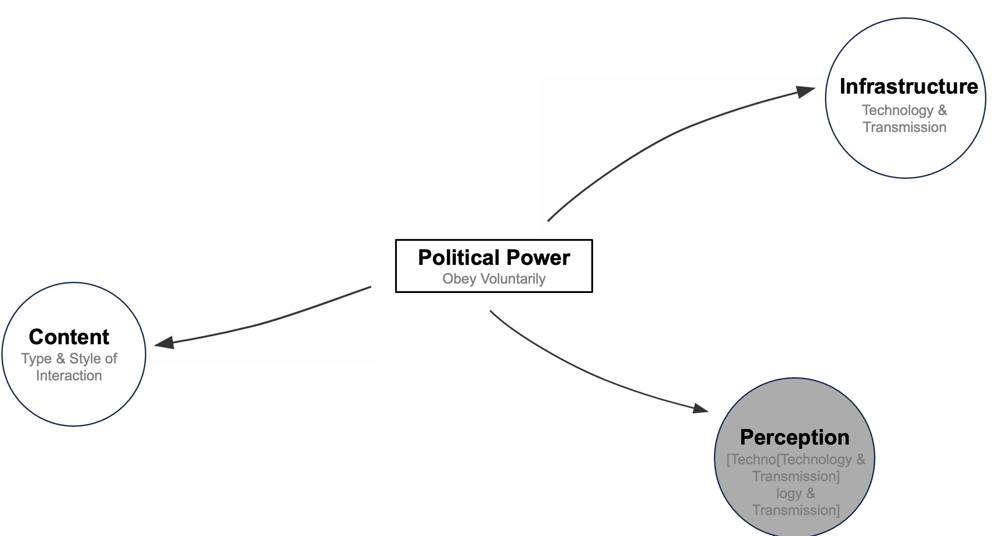
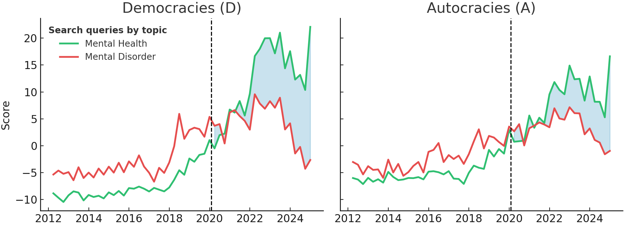
Paths & Pathways
Perception of Information
■ Stress as a political factor
■ Trial By Fire: WP (2014) Stress Amplifies Electoral Gratitude for the Authorities
■ Stress & Political Order in Afghanistan PLoS Mental Health (2025) Gender, Stress, & Political Order in Afghanistan Societies (2025
□ Men ~ State □ Women ~ Men + State
□ Can systematic stresses be used as a mean inside power relations? □ Can we check it cross-nationally? (mental health statistics)
□ Challenge: Underreporting □ Google Trends Data
□ Intermediate findings:
1 Covid-19 shifted the global attention from severe
mental health disorders to milder diagnoses 2 Democracies VS Autocracies

Slide 26

Research Agenda
■ Legitimacy in Recognition Hypotheses □ Informational environments constitute a separate source of authority
□ Cannot be reduced to Weber’s Triad Weber 1919
□ AI-Voice Scams (‘25)
Infrastructure
Technology & Transmission
□ Independent Radio Stations (UR)
□ Political Instability &
Information Technology (‘19)
□ Online Trolls (UR)
Political Power
Obey Voluntarily
□ Trial By Fire (‘14)
□ Stress and Political Order in Afghanistan (‘25)
Content
□ US Women’s Marches (‘20)
Type & Style of Interaction
□ Gender, Stress and Political Order (‘25)
□ Covid-19 & Behavioral Disorders (early)
Perception
Sensors & Stresses

Slide 27




Implications
Vulnerabilities?
Cybersecurity & Labor Markets
Labor-Intensive Worker
Compute-Intensive Worker
Communication-Intensive Worker

Slide 28
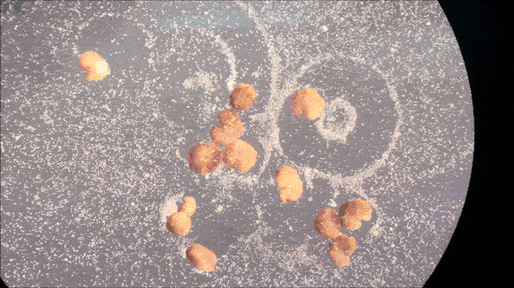
Implications
Cybersecurity & Labor Markets
Xenobots?
Labor-Intensive Worker
Compute-Intensive Worker
Communication-Intensive Worker

